Slide 1
Volume Solids of Known Cross Sections

Slide 2
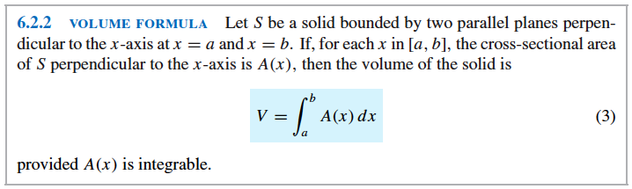
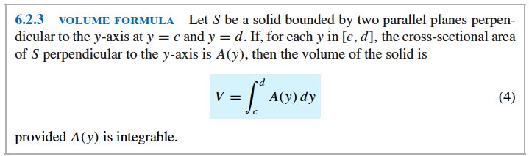

Slide 3
Sample Problems: pp. 429-430
1) # 9. Find the volume of the solid whose base is the region
Bounded between the curve y = x² and the x-axis from x = 0 to
x = 2 and whose cross sections taken perpendicular to the x-axis
are squares.
2) #48 The base of a certain solid is the region enclosed by
y = x½,y = 0, and x = 4. Every cross section perpendicular to the
x-axis is a semicircle with its diameter across the base . Find the
volume of the solid.
3) #49-c Find the volume of the solid whose base is enclosed by
the circle x²+y² = 1 and whose cross sections taken perpendicular
to the y-axis are equilateral triangles.

Slide 4
4) # 20 Find the volume of the solid whose base is the region
enclosed between the curve x = 1 - y² and the y-axis and whose
cross sections taken perpendicular to the y-axis are squares.
5) The base of the solid is an ellipse whose major axis and minor
axis are 12 cm and 8 cm long, respectively. Find the volume of
the solid if every section perpendicular to the major axis is an
equilateral triangle.
6) The base of a solid is the region bounded by y² = 8x and x = 8.
Find the volume of the solid if every section perpendicular to the
axis of the parabola is an isosceles triangle of altitude 10.

